Slide 1
Visitor

Slide 2
Intent
Represent an operation to be performed on the elements of an object structure.
Visitor lets you define a new operation without changing the classes of the elements on which it operates.

Slide 3
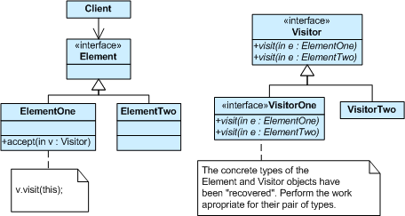
Structure

Slide 4
Why Visitors?
The Visitor pattern is one among many design patterns aimed at making object-oriented systems more flexible
The issue addressed by the Visitor pattern is the manipulation of composite objects.
Without visitors, such manipulation runs into several problems as illustrated by considering an implementation of integer lists, written in Java

Slide 5
Integer lists, written in Java
(Without Generics)
interface List {}
class Nil implements List {}
class Cons implements List {
  int head;
  List tail;
  }
What happens when we
write a program which computes the sum of all components of a given List object?

Slide 6
First Attempt:
Instanceof and Type Casts
List l;
// The List-object we are working on.
int sum = 0;
// Contains the sum after the loop.
boolean proceed = true;
while (proceed) {
if (l instanceof Nil)
proceed = false;
else if (l instanceof Cons) {
sum = sum + ((Cons) l).head; // Type cast!
l = ((Cons) l).tail; // Type cast!
}
}
What are the
problems here?

Slide 7
What are the problems here?
Type Casts?
  We want static (compile time) type checking
Flexible?
  Probably not well illustrated with this example

Slide 8
Second Attempt:
Dedicated Methods
interface List {
int sum();
}
class Nil implements List {
public int sum() { return 0; }
}
class Cons implements List {
int head;
List tail;
public int sum() {
return head + tail.sum();
}
}

Slide 9
Tradeoffs
Can compute the sum of all components of a given List-object l by writing l.sum().
Advantage: type casts and instanceof operations have disappeared, and that the code can be written in a systematic way.
Disadvantage: Every time we want to perform a new operation on List-objects, say, compute the product of all integer parts, then new dedicated methods have to be written for all the classes, and the classes must be recompiled

Slide 10
Third Attempt: The Visitor Pattern.
interface List {
  void accept(Visitor v);
}
class Nil implements List {
public void accept(Visitor v) { v.visitNil(this); }
}
class Cons implements List {
int head;
List tail;
public void accept(Visitor v) { v.visitCons(this);
} }

Slide 11
Second Part of Visitor Idea
interface Visitor {
void visitNil(Nil x);
void visitCons(Cons x);
}
class SumVisitor implements Visitor {
int sum = 0;
public void visitNil(Nil x) {}
public void visitCons(Cons x){
sum = sum + x.head;
x.tail.accept(this); } }

Slide 12
Summary
Each accept method takes a visitor as argument.
The interface Visitor has a header for each of the basic classes.
We can now compute and print the sum of all components of a given List-object l by writing
    SumVisitor sv = new SumVisitor();
    l.accept(sv);
    System.out.println(sv.sum);

Slide 13
Summary Continued
The advantage is that one can write code that manipulates objects of existing classes without recompiling those classes.
The price is that all objects must have an accept method.
In summary, the Visitor pattern combines the advantages of the two other approaches

Slide 14
Summary Table
Frequent
type casts?
Frequent
recompilation?
Instanceof and type casts
Yes
No
Dedicated methods
No
Yes
The Visitor pattern
No
No

Slide 15
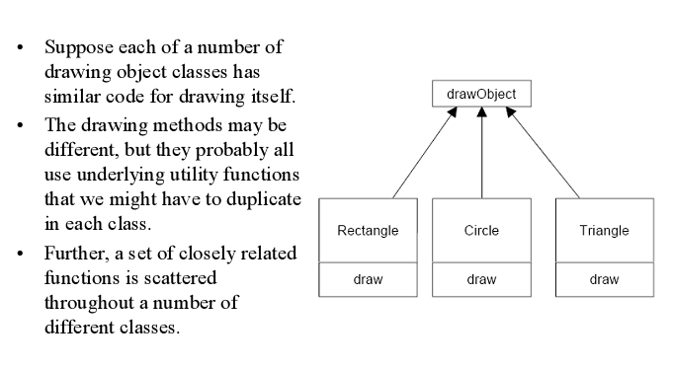
An example

Slide 16
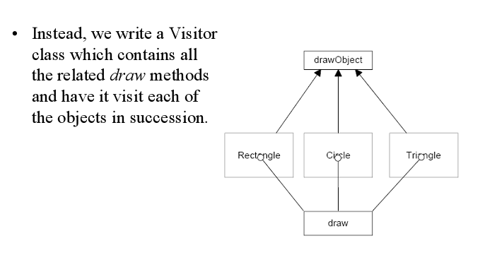
The Visitor Solution

Slide 17
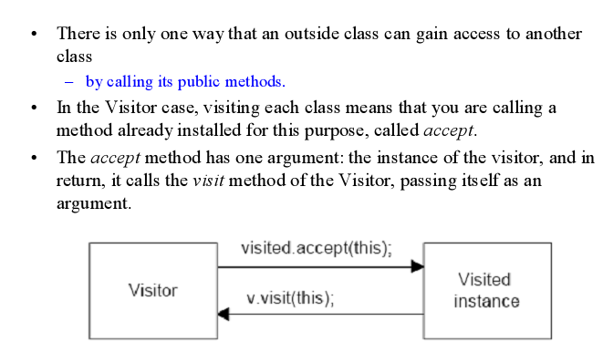
But what does “Visiting” mean?

Slide 18
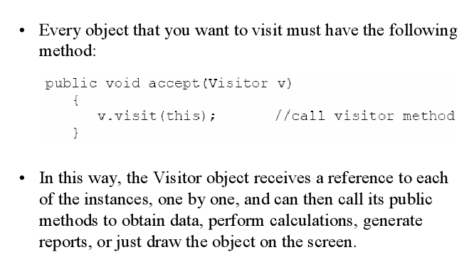
In terms of code…..

Slide 19
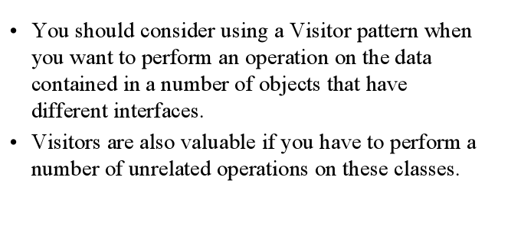
Use a Visitor when…..

Slide 20
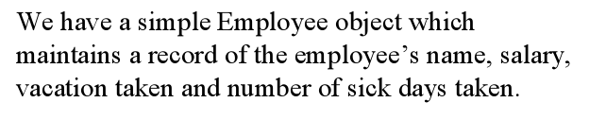
Another Example

Slide 21
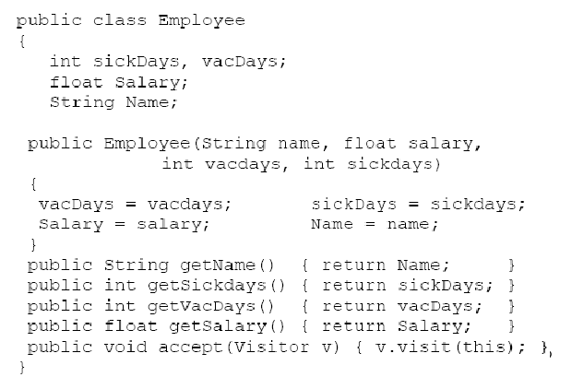
The class

Slide 22
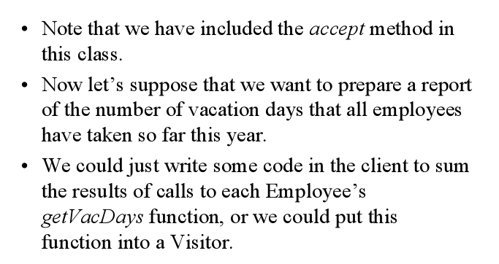
Generating a Report

Slide 23
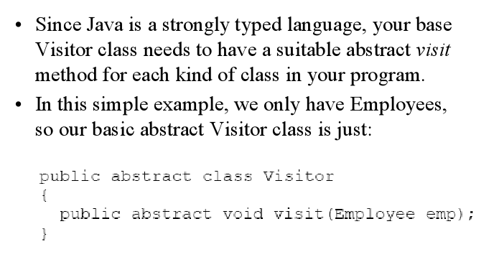
The Visitor Abstract class

Slide 24
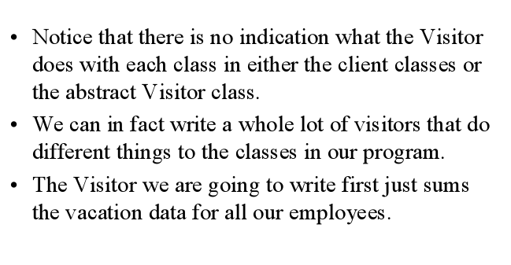
A Concrete Visitor

Slide 25
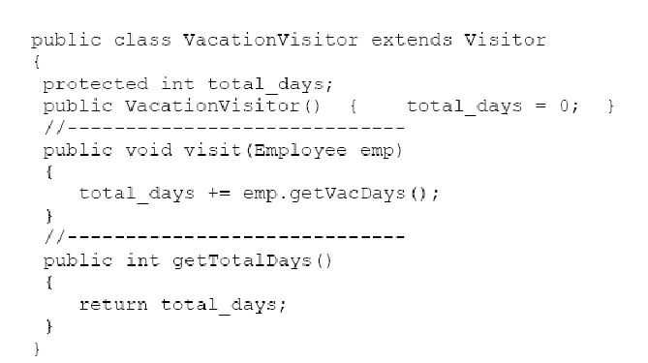
The Concrete Visitor code

Slide 26
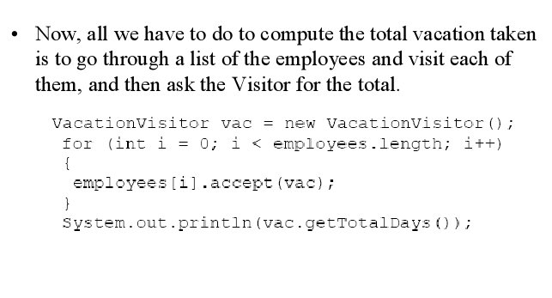
The Main program

Slide 27
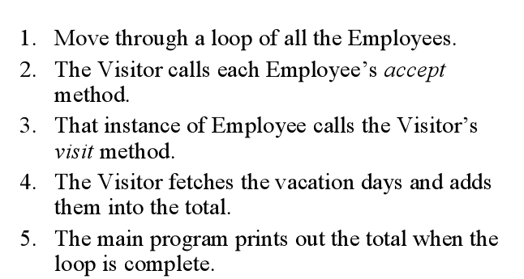
The Steps

Slide 28
Benefits
The visitor pattern is a great way to provide a flexible design for adding new visitors to extend existing functionality without changing existing code

Slide 29
Drawbacks
If a new visitable object is added to the framework structure all the implemented visitors need to be modified.
The separation of visitors and visitable is only in one sense: visitors depend of visitable objects while visitable are not dependent of visitors.
Part of the dependency problems can be solved by using reflection with a performance cost.

Slide 30
Visitors and Iterators
The iterator pattern and visitor pattern has the same benefit, they are used to traverse object structures. The main difference is that the iterator is intended to be used on collections. Usually collections contain objects of the same type. The visitor pattern can be used on complex structure such as hierarchical structures or composite structures. In this case the accept method of a complex object should call the accept method of all the child objects.
Another difference is operation performed on the objects: In one case the visitor defines the operations that should be performed, while the iterator is used by the client to iterate through the objects form a collection and the operations are defined by the client itself.

Slide 31
Visitors and Composites
The visitor pattern can be used in addition with the composite pattern. The object structure can be a composite structure. In this case in the implementation of the accept method of the composite object the accept methods of the component object has to be invoked.

